Slide 1


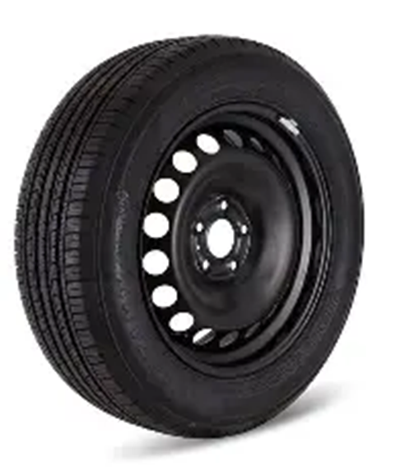
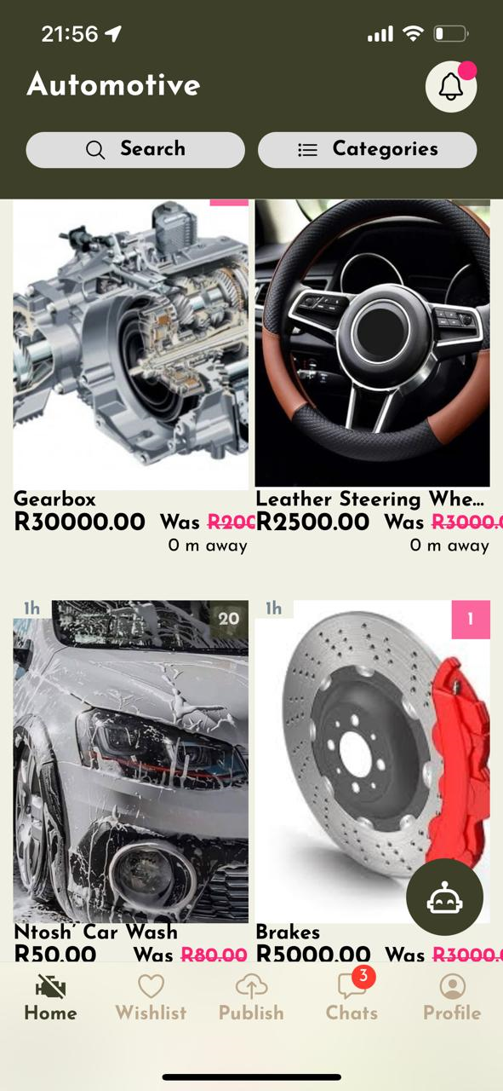
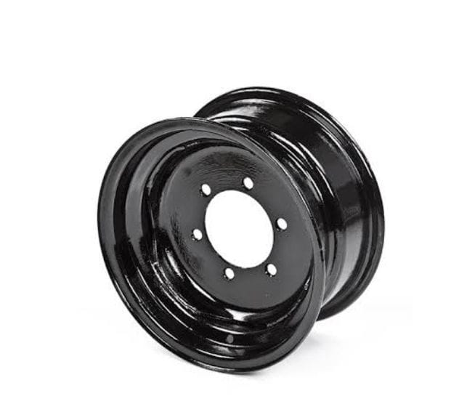
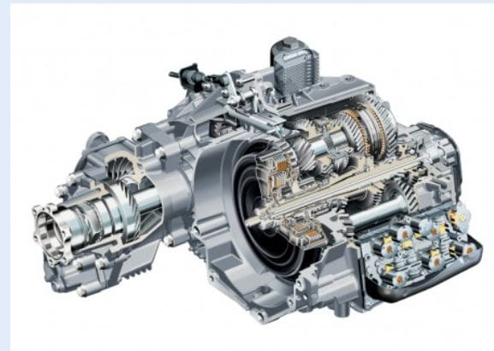
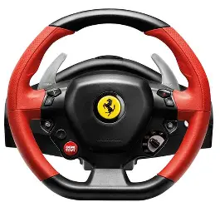



No way—turns out the person selling the car steering I’ve been searching for lives right next door!

Slide 2

Vula moto
Team Name: AfterMarket Accelerators
Pillar 2: Support SSMEs in the After Market
Anelisiwe Khanyisa September
Hons Comp Sc.
Role: Group Leader
Tinashe Crispen Garidzira 3rd Year BSc
Role: Technology Integration
Luthando Candlovu Hons Comp Sci
Role: Designer
Malwande Mdzobo MSc. Comp Sci
Role: Developer
Boneka Ntanjana Hons Comp Sci
Role: Software Tester

Slide 3
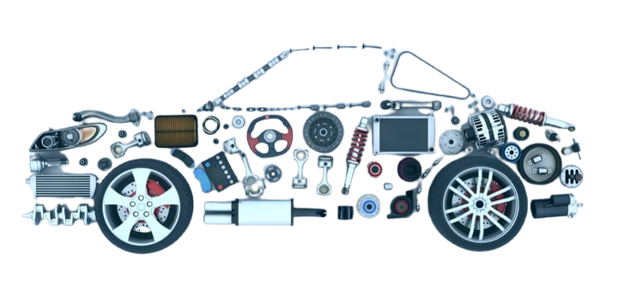
Overview
Introduction
Problem Statement
Solution
Functionality of mobile application
Key features
Sample Screenshots
Conclusion and Future work

Slide 4
Introduction: The Digital Gap
Auto SMMEs in South Africa face challenges like limited digital infrastructure and poor online visibility, hindering growth and service reach. Our platform aims to bridge this gap.
Global Context : Digital tools are vital for economic development and mobility in developing regions [1], [2], [3], [4], [5].
Marketplace Value: Previous studies show digital tools enhance buyer-seller interactions and personalization.
AI Chatbot Impact: AI-based chatbots improve user trust, personalization, and negotiation.
[1] M. Rakhra et al., “An In-Depth Analysis Of Local Mechanic Support For Immediately Apparent Repairs,” ICEECT 2024, 2024.
[2] R. Xi et al., “Aug2Search: Enhancing Facebook Marketplace Search with LLM-Generated Synthetic Data Augmentation,” arXiv, 2025.
[3] Y. Ding & M. Najaf, “Interactivity, humanness, and trust: a psychological approach to AI chatbot adoption in e-commerce,” BMC Psychol., vol. 12, 2024.
[4] M. Sinha & L. Fukey, “Factors Affecting Digital Visibility of SMEs in India,” Vision, vol. 29, 2025.
[5] N. Natalia & P. Hermawan, “Unlocking Potential: Digital Transformation in Automotive Repair,” IJEBCE, vol. 4, 2024.

Slide 5

Problem Statement
Many small auto-repair SMMEs in South African townships lack visibility, digital tools, and customer engagement platforms.
Despite their numbers, township SMMEs face high closure rates due to limited support and digital adoption[1].
[1] M. Sinha and L. Fukey, “Factors Affecting Digital Visibility of Small and Medium Enterprises in India,” Vision, vol. 29, no. 2, pp. 166–176, 2025, doi: 10.1177/09722629211060564.

Slide 6
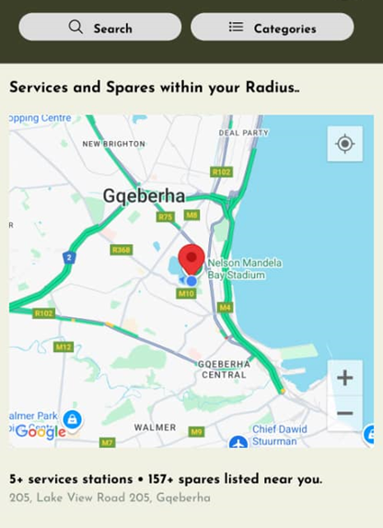
Our Solution
Our target users are Auto SMMEs in South Africa.
Develop a location-based Native Mobile marketplace App for local auto SMMEs.
Connects mechanics with both insured and uninsured vehicle owners.
Offers service listings, live chat, and AI support.
Enhances visibility, trust, and efficiency in underserved communities.

Slide 7
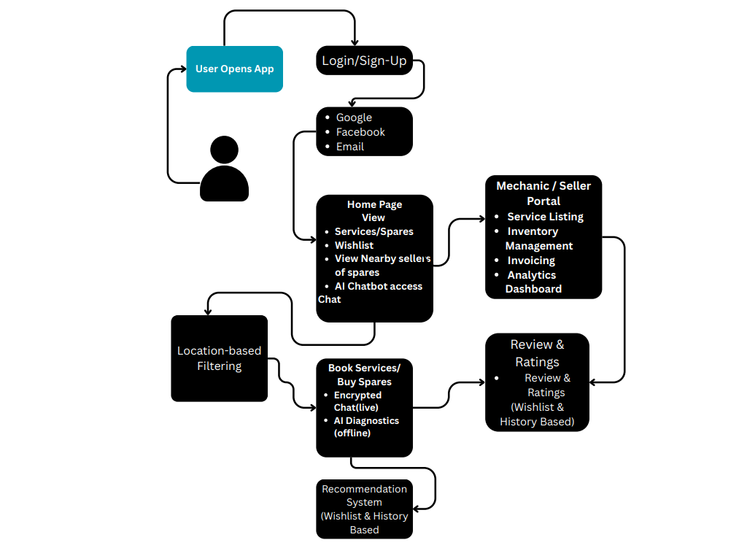
What the App Does
Our app is a location-based marketplace that connects customers with nearby auto-repair and parts SMMEs.
It allows users to:
Showcase services and advertises spares.
Chat directly with customers
Build trust through reviews
Use tools for analytics
Integrated Multilingual Chatbot and Neural Machine Translation to local languages.

Slide 8
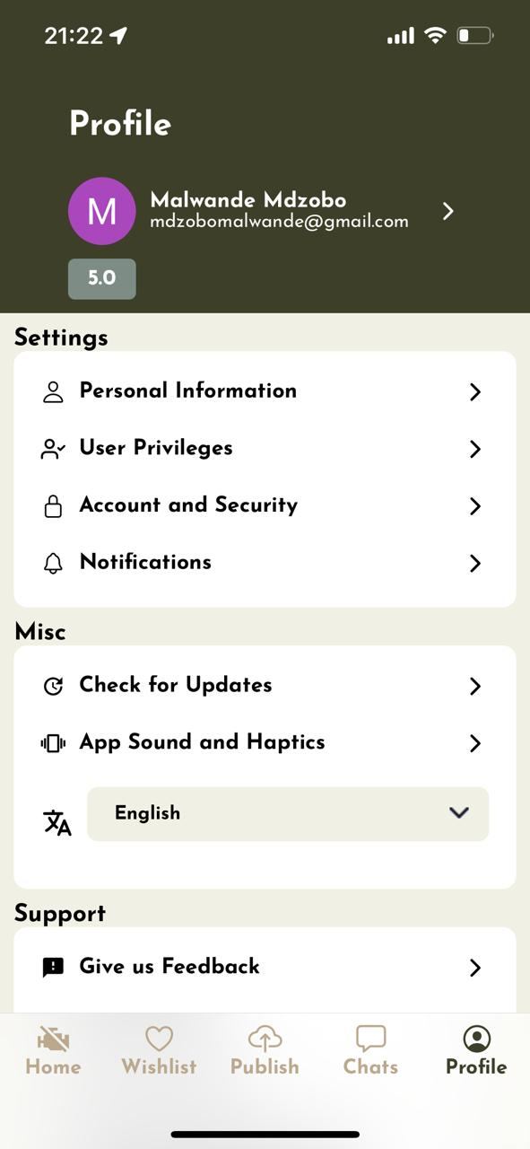
Key Features
Geo-located Listings
Find Services and Spares near you
User app Preference Settings
Real time Chat and Notification system
Customer Reviews, Feedbacks and Seller Ratings
Home Services and Spares Listing

Slide 9

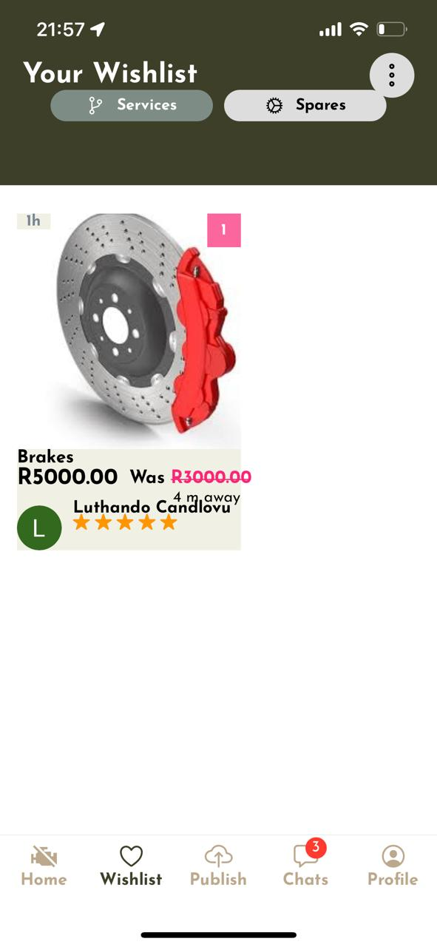
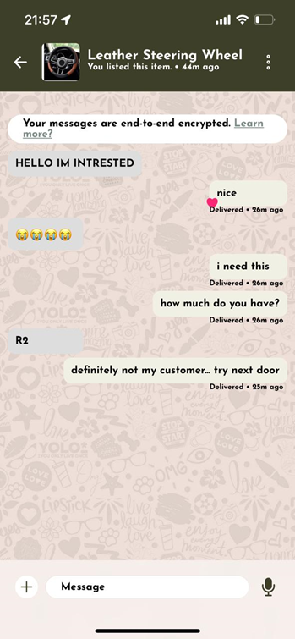
Home Screen
Profile Screen
Wishlist Screen
Chat Screen

Slide 10
Conclusion and future works
In conclusion, Vula Moto is driving positive change in the auto-repair sector by equipping small businesses with digital tools, improving customer access and trust, and setting the stage for future innovations like mobile payments and smart diagnostics.
In the future we intent to
Build a full server that will handle secure payment system using services like Stripe.
Build a recommendation AI server based on the user’s bookmarks.
Use AI to link customers with the best nearby service provider.
Consider conducting in-depth research on effective methods for handling user data securely during authentication and authorization, as well as strategies for detecting and preventing scams.

Slide 11
Acknowledgments
Automotive Industry Development Centre SOC Ltd
UYILO E-MOBILITY PROGRAMME
AIDCEC Hackathon
The Cyber-Physical Factory
University of Fort Hare

Slide 12
APP Demonstration

